Slide 1

Database Fundamentals

Slide 2
Databases
A database is a collection of data.
How that data is organized determines
what type of database it is.
Over the history of computers there have been different types of databases—hierarchical and network, for example—but over the past 25 years the relational database has been the most prevalent.

Slide 3
Relational Databases
E. F. Codd, a researcher at I.B.M., published a paper at the beginning of the 1970s in which he proposed the terms and principles of relational databases. These principles are based on relational algebra.
Peter Chen, a professor in computer science, wrote a paper in 1976 that presented the concepts and symbols for the entity relationship model. This modeling approach has been widely used to depict the data in a relational database.

Slide 4
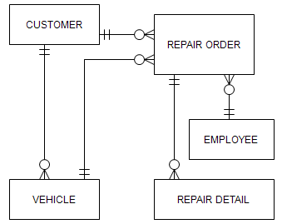
Database – An example
This diagram is an example of an entity relationship diagram (ERD).
This diagram is for the data used in an auto repair business.
This diagram depicts how the relational database is structured.

Slide 5
Databases – Why bother?
Databases are important because almost everyone—businesses, government agencies, schools, etc.—need to keep track of data over time.
Whether it is a business that wants to keep a record of its customers and its inventory or a non-profit agency that wants to keep track of donors and donations, storing and retrieving that information efficiently requires a database.
Information and data: A distinction is usually made between these two terms. Information is data organized in a way that is useful to someone—for example, a list of phone numbers and email addresses for employees in the marketing department sorted by last name. All the details about employees—first name, last name, phone number, pay rate, social security number, department, etc.—are the data stored in the database.

Slide 6
Database Management System (DBMS)
A DBMS is software that provides tools for building and managing a database.
Examples of relational DBMS software are:
Microsoft Access
SQL Server
Oracle
DB2
MySQL

Slide 7
Model notation
The are relatively few symbols in data modeling but many terms and concepts are represented by a deceptively simple set of symbols.
We can’t seem to agree! There is than one set of symbols (a.k.a. notation) used for data modeling. There is no consensus among IS professionals on which set to use.
We’ll use the crow’s feet notation. It is commonly found in systems analysis and design textbooks.
Once you become comfortable with data modeling terms—what they are and, more importantly, what they mean—you’ll find it fairly easy to switch from one notation to another.

Slide 8
Data Model – Entity
Entity: An entity is a person, place, thing or event about which we want to store information. Example entities are: customer, inventory, project, etc.
Entity type and entity: We usually say “entity” but you may also hear “entity type”.
Entity and entity instance: An entity instance is a single occurrence of an entity. For example: Bob Wilson is an instance of the entity CUSTOMER.
The symbol for an entity is a rectangle:
ENTITY

Slide 9
Data Model – Attribute
Attribute: An attribute is a single unit of information that describes something about an entity.
An entity usually has many attributes.
Example: For a CUSTOMER entity, we probably want to know the customer’s first name, last name, address, home phone number, etc.
CUSTOMER
Cust_First_Name
Cust_Last_Name
Cust_Phone
ENTITY
Attribute1
Attribute 2

Slide 10
Data Model: Different kinds of attributes
EMPLOYEE
Emp_ID
Emp_First_Name
Emp_Last_Name
{Emp_Phone}
In this example of an EMPLOYEE entity, some of the attributes have additional notation that is important to understand.
EMP_ID is an identifier. Each entity instance has a unique value for the identifier attribute. Another way to put this: Each identifier value uniquely identifies one entity instance.
Emp_Phone is a multivalued attribute. That means each employee may have more than one phone number. So, this “phone number” attribute can have more than one value for each entity instance.
Karla Stevens has employee ID 3492.
David Adams has employee ID 4382.
Karla Stevens has a number for her office phone number, her cell phone, and her home phone.

Slide 11
Data Model – Relationship
Within the data model, one entity is related to one or more entities.
A line represents a relationship between two entities.
In the example below a CUSTOMER is related to an ORDER and an ORDER is related to INVENTORY. (Attributes aren’t shown in order to simplify the diagram.)
CUSTOMER
ORDER
INVENTORY

Slide 12
Data Model - Cardinality
Cardinality symbols show the minimum and maximum constraints on a relationship (and here is where the “crow’s feet” come in).
The next presentation will discuss cardinality in greater detail but the example below shows 3 symbols: a vertical line, a zero, and crow’s feet (3 lines projected from a single point).
CUSTOMER
ORDER
INVENTORY

Slide 13
Relationships and cardinality
What do the relationships symbols really mean to us? Here are a few examples of how to read the minimum and maximum symbols.
A customer can have a minimum of zero orders.
A customer can have a maximum of many orders.
An order is for a minimum of one customer.
An order is for a maximum of one customer.
CUSTOMER
ORDER
LOCATION
EMPLOYEE

Slide 14
Relationships
Based on maximum cardinality, a relationship falls into one of three types:
one-to-many
many-to-many
one-to-one
one-to-many
many-to-many
CUSTOMER
ORDER
INVENTORY
one-to-one
LOCATION
EMPLOYEE

Slide 15
Maximum Cardinality
Keep in mind that the 3 relationship types (1-to-1, 1-to-many, and many-to-many) describe the maximum cardinality at both ends of a relationship.
It’s incorrect to read the minimum and maximum cardinality as “one-to-many”, for instance.
This is many-to-many.
This is NOT one-to-many
ORDER
INVENTORY
This is NOT one-to-one
This is one-to-many.
CUSTOMER
ORDER

Slide 16
Degree of the relationship - Unary
The degree of the relationship refers to the number of entities in a single relationship.
The options are: unary, binary, ternary.
A unary relationship means a entity is related to itself. There is only one entity.
Supervises
Any one employee—Casey Wilson, for example—may be supervised by a minimum of zero employees.
Any one employee—Casey Wilson, for example—may be supervised by a maximum of one employee.
Any one employee—Carla Stevens, for example—may supervise a minimum of zero employees.
Any one employee—Carla Stevens, for example—may supervise a maximum of many employees.
EMPLOYEE
Supervised by

Slide 17
Degree of the relationship - Binary
A binary relationship means two entities are directly related. This is by far the most common one you see in a data model.
Any one order—order ID # 4528, for example—may have a minimum of one inventory items in the order.
Any one order—order ID # 4528, for example—may have a maximum of many inventory items in the order.
Any one inventory item—Day-Glow Toothpaste, for example—may be sold in a minimum of zero orders.
Any one inventory item—Day-Glow Toothpaste, for example—may be sold in a maximum of many orders.
ORDER
sold in
INVENTORY
has

Slide 18
Degree of the relationship - Ternary
A ternary relationship means three entities are directly related. However, this three-way relationship between three entities can be decomposed into binary relationships. Therefore, we won’t spend more time on this term.

Slide 19
Cardinality: Define a relationship
In a relationship between two entities (or an entity related to itself), the minimum and maximum cardinalities are defined by asking two questions from each end of the relationship.
In the example below you must determine the minimum and maximum cardinality from the “customer” side for its relationship to order.
Next, you must determine the minimum and maximum cardinality from the “order” side for its relationship to customer.
Q4
Q3
Q1
Q2
CUSTOMER
ORDER

Slide 20
Define a relationship: 2 questions
Let’s walk through a detailed example of defining the relationship.
Defining CUSTOMER’s relationship to ORDER.
Q1 Minimum cardinality: For any one customer—Sylvia Sanchez, for example—what is the minimum number of orders allowed?
Q2 Maximum cardinality: For any one customer—Sylvia Sanchez, for example—what is the maximum number of orders allowed?
CUSTOMER
ORDER

Slide 21
Define a relationship: 2 more questions
Defining ORDER’s relationship to CUSTOMER.
Q3 Minimum cardinality: For any one order—order # 2573, for example—what is the minimum number of customers allowed?
Q4 Maximum cardinality: For any one order—order # 2573, for example—what is the maximum number of customers allowed?
CUSTOMER
ORDER

Slide 22
Reading the relationship
How would you read the relationship shown below? You can interpret the relationship based on the way you know it was defined.
Any one department, such as marketing, can have a minimum of zero employees.
Any one department, such as marketing, can have a maximum of many employees.
Any one employee, such as Jack Jenkins, can have a minimum of one departments.
Any one employee, such as Jack Jenkins, can have a maximum of one departments.
DEPARTMENT
EMPLOYEE

Slide 23
Logical & physical models
A data model can be documentation of how an existing database is constructed or it can be the tool for designing a new database.
Depending on the level of abstraction or the level of detail, we may classify a data model as logical or physical.
A logical data model is a general depiction of the data—entities and relationships.
A physical data model shows enough detail to depict how the database is built.

Slide 24
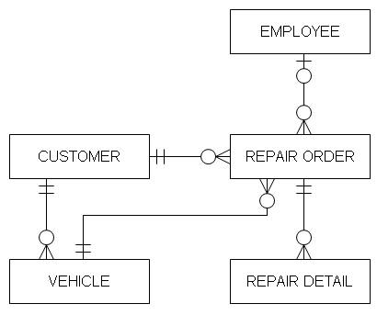
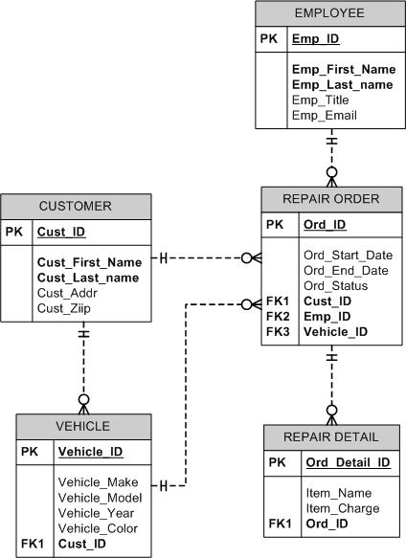
Examples: Logical & physical models
The examples shown here are for an auto repair shop.
The logical model is on the top.
It shows entities and relationships.
It might also show some attributes.
The physical model, as you can see here, shows a great deal more detail.
In future presentations we’ll find out what ‘PK’ and ‘FK’ represent and why some attributes are in bold text.
The physical model shown here was created in Microsoft Visio.

Slide 25
Physical model -> relational database
When we go from the model to the database, the terminology changes.
Entity … becomes … table
Attribute … becomes … column or field
Entity instance … becomes … a row in a table (also called a record).
Relationship … becomes … a column (or columns) that is in each table at both ends of the relationship.

Slide 26
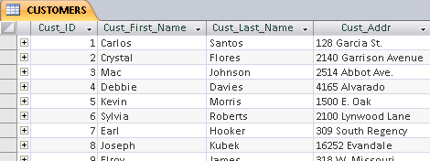
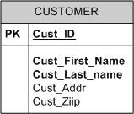
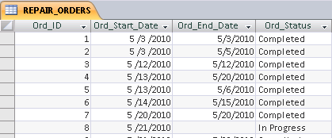
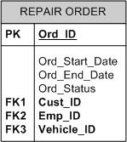
From model to database – An example
CUSTOMER and REPAIR ORDER entities in the data model will become CUSTOMERS and REPAIR ORDERS tables in the database. (It’s not necessary but it is customary to use singular terms in the model then make these plural in the database.)

Slide 27
Entity instance = row in a table
One of the principles of relational databases is that each row in a table is unique.
Primary key: A field (or combination of fields) that uniquely identify one row in the table.
Remember the identifier in the data model? That was one or more attributes used to uniquely identify an entity instance. The identifier in the model becomes the primary key in the database.
Many attributes or fields are not unique. For example, names, addresses, and phone numbers may not be unique for each customer, employee, or student.
So, we often create an identifier or primary key field to uniquely identify each instance of an entity—each row in a table.

Slide 28
What you should already know …
You should know relational data model terminology.
You should know the database terms that correspond to the data model terms.
For example: attribute = column/field
In the previous presentation, we started implementing a physical data model in a relational database.
This presentation begins with how to implement the relationship between two entities.

Slide 29
Database “relationships”
How do we put a “relationship” between the CUSTOMER and REPAIR ORDER tables in the database?
We put the primary key from one table into the related table.
Which primary key goes into the other table?
CUSTOMER
REPAIR ORDER

Slide 30
Foreign key
Foreign key: A foreign key is a field in one table that corresponds to a primary key field in another table.
We know which primary key to put in a related table because of the “one” side and the “many” side of the relationship.
The rule: In a one-to-many relationship the “many” side gets the foreign key.
One-to-many
CUSTOMER
REPAIR ORDER
The REPAIR ORDER table gets the foreign key column.

Slide 31
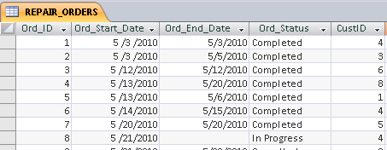
Foreign key: Building a relationship
The primary key field from CUSTOMER, which is CUST_ID, has a corresponding column in the related REPAIR ORDER table.
The foreign key field, called CUSTID column in the example shown here, holds data that links to related data in the CUSTOMER table.
CUSTOMER
REPAIR ORDER
For repair order #1 (Ord_ID), the #4 in the CustID field, tells us that this work was done for Debbie Davies.

Slide 32
Data redundancy
Using the foreign key field to link related data is an essential element of relational database.
It reduces data redundancy.
Each relational database table stores data about a particular entity (a person, place, thing, or event).
In the example below, there are 3 repair orders for Debbie Davies.
However, we don’t store her information (name, address, etc.) more than once. The foreign key value #4 links Debbie Davies’ information to each of her repair orders.

Slide 33
Foreign key field name
The foreign key field name can match the related primary key field name exactly. This is often done.
However, as shown in the example here, it is not required that the names match. In fact, in one situation, which you’ll see later, the names cannot match.
It is required that the foreign key column be defined so that it contains the same data as in the related primary key column. The foreign key column is the same data type and field size as the primary key column.

Slide 34
Many-to-many relationship
Now, we look at implementing a many-to-many relationship in a relational database.
In a many-to-many relationship, like the one between REPAIR ORDER and INVENTORY, neither side gets a foreign key.
In fact, you can’t build a many-to-many relationship in a relational database.
REPAIR ORDER
INVENTORY

Slide 35
Many-to-many: add associative entity
A many-to-many relationship must be decomposed into at least two one-to-many relationships.
You add an associative entity that links the two original entities.
a.k.a. (also known as) conjunction entity
a.k.a. intersection entity
REPAIR ORDER
REPAIR ORDER
INVENTORY
REPAIR DETAIL
INVENTORY

Slide 36
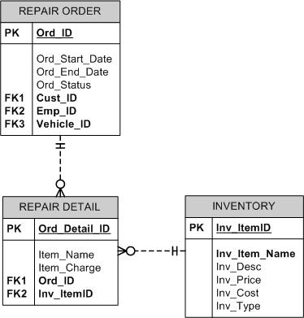
Many-to-many: Physical model
A many-to-many relationahip is appropriate in a logical data model
The physical data model should not contain many-to-many relationships.
They should be decomposed into one-to-many relationships.
REPAIR ORDER
INVENTORY

Slide 37
Associate entity -> Building the table
For the auto repair shop example, you’ll build a table called REPAIR DETAILS.
This table has a foreign key field from REPAIR ORDERS
It also has a foreign key field from INVENTORY.
A table can have many foreign keys or it can have none. It depends on its relationships with other tables.

Slide 38
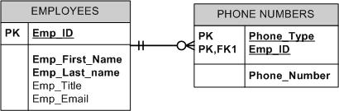
Concatenated primary key
The entity on the left depicts a multivalued attribute.
The physical data model shown on the right illustrates how a multivalued attribute is transformed.
The primary key from the parent entity usually becomes part of the primary key in the child entity (Emp_ID in EMPLOYEE, in this case).
Remember, a primary key can consist of more than one field.
A concatenated primary key consists of two or more fields.
EMPLOYEE
Emp_ID
Emp_First_Name
Emp_Last_Name
{Emp_Phone}

Slide 39
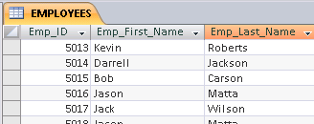
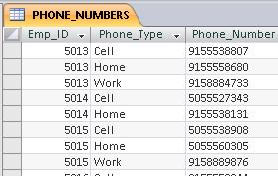
Multivalued attribute implementation
The examples below illustrate the transformation from
a logical entity
to a physical design
to the tables in the relational database.
EMPLOYEE
Emp_ID
Emp_First_Name
Emp_Last_Name
{Emp_Phone}

Slide 40
Test what you know about relational database fundamentals
This presentation has questions to test what you understand about relational databases—the models and the construction.
The answers are not provided. If you’re not certain about your answers, review the presentations about database fundamentals.

Slide 41
A few questions …
What is the data model term that has this definition? “A person, place, thing, or event about which we need to keep information.” ______________
What is a field called if it is used to link to a primary key field in another table? ______________
A field (or fields) that uniquely identifies each row in a table is called a(n) ____________ ?

Slide 42
A few more questions …
If a relationship in the data model has a maximum cardinality of “one” on one end and “crows feet” on the other end, what type of relationship is this? _____-____-______
Which of the following could be a primary key for the EMPLOYEE table?
a. First Name + Last Name
b. Phone Number
c. Job Title
d. Social Security Number
e. Birth Date

Slide 43
A few more questions …
E. F. Codd proposed the principles for __________ databases, which is the type of database most widely used today.
An attribute that might have more than one value for each entity _________, is called a __________ attribute.

Slide 44
Test your understanding of data models and databases.
Now, you’ll see some data models and answer questions about them.
You don’t have to know the business setting in order to read these models; just interpret what the data model depicts.

Slide 45
Test your understanding of data models and databases.
In the data model shown, how many tables would you build in the database?
for
in
CUSTOMER
ORDER
INVENTORY
has
of

Slide 46
Test your understanding of data models and databases.
Which of these would get a foreign key? Check all that apply.
CUSTOMER
ORDER
INVENTORY
None would.
All would.
for
in
CUSTOMER
ORDER
INVENTORY
has
of

Slide 47
Test your understanding of data models and databases.
In the data model shown, how many tables would you build in the database?
EMPLOYEE
ASSIGNMENT
PROJECT

Slide 48
Test your understanding of data models and databases.
Which of these would get a foreign key? Check all that apply.
EMPLOYEE
ASSIGNMENT
PROJECT
None would.
All would.
EMPLOYEE
ASSIGNMENT
PROJECT

Slide 49
Test your understanding of data models and databases.
In the data model shown, how many tables would you build in the database?
VENDOR
VendID
VendName
{Phone}
PART
PartID
PartDesc
BILL OF MATERIALS
BOM_ID
BOM_Title

Slide 50
Test your understanding of data models and databases.
In the data model shown below, which of these would get a foreign key? Check all that apply.
VENDOR
PART
BILL OF MATERIALS
None would.
All would.
VENDOR
PART
BILL OF MATERIALS

